Slide 1
Probni naslov
Autori, datum

Slide 2
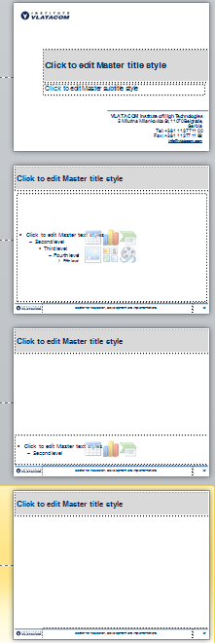
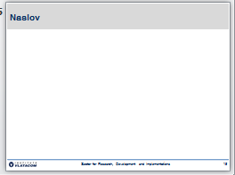
PPT podrazumevani format – prilagođen svrsi, ne samo formi (na primer, za pokretanje projekta)
Samo četiri stila:
Traka za naslov (1 ili 2 reda, pune širine)
1. naslov
2. Tekst
(buliti)
3. Slika i
komentar
ispod slike
Broj slajda
4. Samo
slika
Logo Insituta
Zona za referenciranje
(ili naziv sektora
Ako se ništa ne referencira)

Slide 3

Project Scope
1 Scope
1.1 Final Product Deliverables
1.2 Organizational Deliverables
1.3 Non-typical Project Management Deliverables
1.4 In-scope Details
1.5 Out-of-scope Details
1.6 Customer Needs and Requirements
1.7 Quality Objectives
1.8 Customer Acceptance Criteria
Work Breakdown Structure
(ref MS Project, milestones!)
3 Organizational Breakdown Structure
Responsibility Matrix
Project Budget
(ref Excel)
Appendix

Slide 4

Thank you for your attention! Any questions?
info@vlatacom.com

